Slide 1
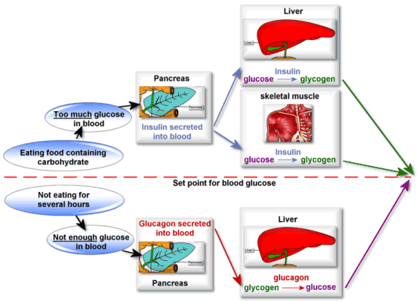

Slide 2
GLUCOSE
Glucose originates from the digestion of carbohydrates (or intake of simple sugars) that are ingested.
Glucose is absorbed into the capillaries of the villi in the small intestine.
Glucose then travels from the small intestine to the liver via the hepatic portal vein.
The liver is the first organ that glucose goes to.

Slide 3
THE LIVER GLUCOSE OPTIONS
Use glucose as energy for liver cell functioning.
Convert glucose into glycogen for storage in liver (GLYCOGENESIS).
Allow the glucose to continue to circulate in the blood in order to make glucose available to body cells
Glucose converted to fat for long term storage in adipose tissue

Slide 4
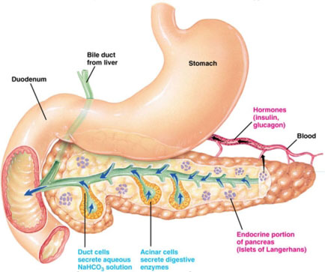
PANCREAS ROLE
The pancreas secretes the hormones insulin and glucagon and acts as a endocrine gland.
The pancreas also secretes digestive enzymes into a duct that opens into small intestine: acts as exocrine gland too.

Slide 5
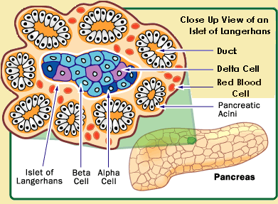
ISLETS OF LANGERHANS Alpha cells secrete glucagon Beta cells secrete insulin

Slide 6
INSULIN FROM BETA CELLS DECREASES BLOOD GLUCOSE BY;
If blood sugar levels rise above normal, chemo receptors in beta cells of Islets of Langerhans stimulate cells to secrete insulin.
Enabling transport of glucose from blood into cells, especially in skeletal muscles and cause decrease of blood sugar.
Promoting glycogenesis (conversion of glucose into glycogen in liver and skeletal muscles).
Stimulating the conversion of blood glucose into fat and storing the fat in adipose tissue.
4. It also promotes increase in protein synthesis in some cells.

Slide 7
GLUCAGON FROM ALPHA CELLS INCREASES BLOOD GLUCOSE BY;
If blood sugar levels fall below normal, chemo receptors in alpha cells of Islets of Langerhans stimulate alpha cells to secrete glucagon.
Stimulating GLYCOGENOLYSIS – the conversion of glycogen from the liver & skeletal muscles back into glucose.
Stimulating GLUCONEOGENESIS- the production of glucose from fat and protein stores.
Has a mild effect on protein break down.

Slide 8
ADRENAL CORTEX ROLE IN BLOOD SUGAR REGULATION
ACTH (adrenocorticotropic hormone) produced and secreted by anterior pituitary stimulates adrenal cortex to secrete cortisol.
Functions of cortisol (INCREASES BLOOD GLUCOSE):
Stimulate conversion of glycogen to glucose in liver (GLYCOGENOLYSIS).
Increase amino acid removal from cells and transport to liver, here amino acids can be converted to glucose (GLUCONEOGENESIS).
Mobilise fatty acids form stored fat (adipose) tissue, muscles can use fatty acids for energy (GLUCONEOGENESIS).

Slide 9
ADRENAL MEDULLA ROLE IN BLOOD SUGAR REGULATION
Secretes noradrenaline and adrenaline
ADRENALINE INCREASES BLOOD SUGAR BY;
Stimulating the conversion of glycogen to glucose (GLYCOGENOLYSIS) – increase blood sugar and counteract the effect of insulin
Stimulates production of lactic acid from glycogen in muscles and lactic acid used by liver to make glucose.

Slide 10
LOW BLOOD SUGAR
STIMULUS - Low blood glucose levels.
RECEPTOR- Alpha cells in the “Islets of Langerhans” in the pancreas.
MODULATOR- The alpha cells produce and release more glucagon into the bloodstream. Adrenal cortex releases cortisol and adrenal medulla adrenaline.

Slide 11
LOW BLOOD SUGAR Cont…
EFFECTOR Somatic (body) cells, Liver, Skeletal muscles.
RESPONSE Gluconeogenesis of fats and amino acids to glucose.
Glycogenolysis of glycogen to glucose in the liver & skeletal muscles
FEEDBACK Blood glucose levels increase

Slide 12
HIGH BLOOD SUGAR
STIMULUS- High blood glucose levels
RECEPTOR- Beta cells in the “Islets of Langerhans” in the pancreas.
MODULATOR-The beta cells produce and release more insulin into the bloodstream

Slide 13
HIGH BLOOD SUGAR Cont..
EFFECTOR -Somatic (body) cells, Liver, skeletal muscles
RESPONSE - Increased uptake of glucose from the blood into the body cells.
Glycogenesis of glucose to glycogen for storage in the liver & skeletal muscles
Glucose converted to fat in the liver
FEEDBACK- Blood glucose levels decrease

Slide 14
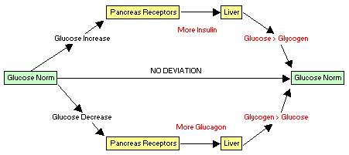

Slide 15
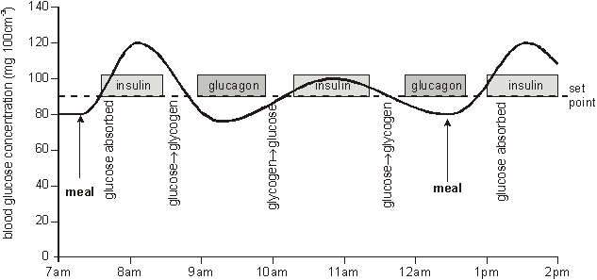

Slide 16
REGULATION OF GAS CONCENTRATIONS
Respiratory centre: medulla oblongata
1. oxygen concentration: plays role if oxygen levels fall below level and all other factors constant
chemoreceptors in carotid and aortic bodies sensitive to oxygen concentration

Slide 17
CO₂ concentration
Increase in CO₂ concentration = increase in H⁺ ion concentration.
Increase in above concentrations, stimulates central (medulla oblongata) and peripheral chemoreceptors (carotid and aortic)
Central chemoreceptors in medulla oblongata are most sensitive to CO₂ concentration.
Responsible for 70 – 80% of increase in breathing rate, but can take several minutes.

Slide 18
H⁺ ion concentration
As H⁺ ion concentration increase, pH decrease and blood becomes acidic.
Decrease in pH stimulate peripheral chemoreceptors in aortic and carotid bodies.
Transmit to respiratory centre in medulla oblongata.
This cause an increase in breathing rate.
This causes an immediate increase in breathing rate

Slide 19
Voluntary control of breathing: bypass the respiratory centre
Holding your breath
Hyperventilation: rapid deep breathing provide more oxygen and remove more carbon dioxide than necessary
Can correct itself because no urge to breath because the low carbon dioxide concentration
Dangerous when hyperventilating before swimming: Explain

Slide 20
REGULATION OF HEART RATE AND BLOOD PRESSURE
Heart rate – number of times the heart beats/min.
Stroke volume – volume of blood forced from heart
with each contraction.
Cardiac output = heart rate(beats/min) x stroke volume (ml)
Venous return – volume of blood returning to the heart
Blood pressure – force with which blood presses on walls
of blood vessels.

Slide 21
Regulation of heart rate:
Sinoatrial node (SA node) sends nerve impulses that spread through atria.
Stimulus reaches AV node and atria contracts.
AV node sends impulses down fibres of septum between ventricles.
Impulses spread through ventricle fibres.
Ventricles contract.

Slide 22
Heart rate cont.
SA node can stimulate heart beat on its own.
Activity of SA node is influenced by autonomic nervous system – parasympathetic and sympathetic.
Cardiovascular regulating centre in medulla oblongata sends messages to atria, SA node, AV node and blood vessels.
Ventricles receive messages mainly from sympathetic system.
Sympathetic nerve fibres release neurotransmitter noradrenaline which stimulate increase in heart rate and stroke volume.
Parasympathetic nerves causes release of acetylcholine which decreases heart rate and strength of contraction.
Pressoreceptors or baroreceptors in cardiovascular system , and especially carotid artery and aorta, respond to change in blood pressure and sends messages to medulla oblongata.

Slide 23
Factors influencing stroke volume
Length of diastole
Venous return affected by:
activity of skeletal muscles
Respiratory movements to ventilate lungs
Ease with which blood follows through
veins and arteries
Noradrenaline released by sympathetic nervous system

Slide 24
EFFECT OF EXERCISE ON HEART RATE
Body requires more energy during exercise.
Large increase in blood flow required to supply oxygen and nutrients to cells and remove carbon dioxide and heat.
Cardiac output can increase from 5 L/min. to 30 L/min in trained athlete.
Dilation of blood vessels to muscles.
Constriction of blood vessels to internal organs e.g. small intestine.
Anticipatory response is brought about by ANS before you exercise and brought about by adrenaline.
Effect is that the heart rate and stoke volume increase and increase of blood flow to skeletal muscles.
During exercise, cells require energy continuously.
Waste produced e.g. CO₂ and lactic acid act as vasodilators that cause widening of arterioles, lead to increase blood flow to muscles for further supply of O₂and nutrients.

Slide 25
Cont.
Lots of heat also released during cellular respiration, lead to increase of body temperature, this cause an increase in heart rate that stimulates heart to discharge impulses at faster rate.
Squeezing of skeletal muscles on veins returning to heart, increase venous return.
This causes stretching of heart muscle.
This increase stroke volume.
Causing a stronger heart beat.
Blood pressure increase (blood that congest in atria stretch the walls).
Pressoreceptors are stimulated in carotid arteries and aorta.
Nerve impulses send to medulla oblongata.
Sympathetic nerves transfer impulses to the heart via cardiac nerve.
Noradrenaline released at the nerve endings
SA node passes impulses on to AV node
Heat beats faster.

Slide 26
OTHER FACTORS AFFECTING HEART RATE
Age: fastest at birth, slow as we grow older, to about 70-8-b/min in adulthood. Drops below average in old age.
Sex: males have slower heart beat than females on average
Emotional state: anger, fear, anxiety increase heart rate and those like depression and grief decrease heart rate.

Slide 27
Regulation of the normal breathing cycle
Quiet breathing
Inspiration
Inspiratory nucleus activated
Nerve impulses sent to respiratory muscles
Respiratory muscles contract
(2 seconds)
Expiration
Inspiratory nucleus suppressed
Respiratory muscles relax
(3 seconds)

Slide 28
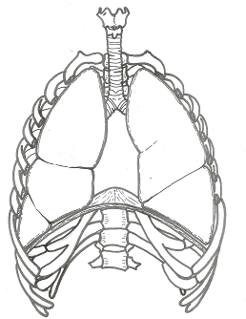
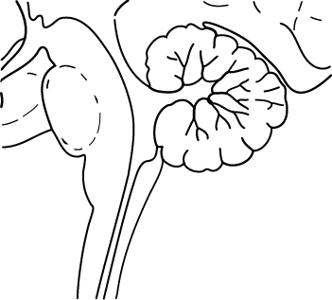
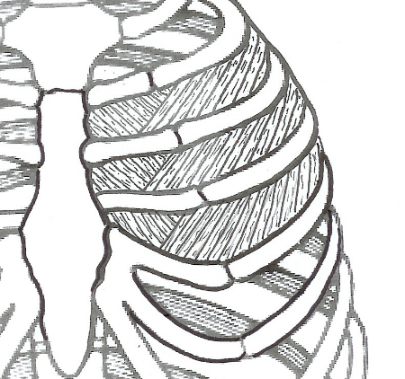
Control of normal breathing
Impulse to diaphragm & external intercostal muscles
INHALE
+
-
Inspiratory nucleus
Exspiratory nucleus
EXHALE
Medullary rhythmicity centre
Impulse to internal intercostal muscles

Slide 29
Regulation of forced breathing
Forced breathing
Inspiration
Inspiratory nucleus activated/ expiratory nucleus suppressed
Nerve impulses sent to respiratory muscles
Inspiratory muscles contract/expiratory muscles relax
Expiration
Expiratory nucleus activated/Inspiratory nucleus suppressed
Nerve impulses sent to respiratory muscles
Expiratory muscles contract/Inspiratory muscles relax

Slide 30
Respiratory reflexes
Normal breathing is modified by:
Changes in levels of oxygen & carbon dioxide
Changes in blood pressure
Stretch receptors in lungs
Irritants (sneezing, coughing etc.)
Sensations such as cold or pain

Slide 31
Effect of high CO₂/low O₂ on breathing
Stimulus - High CO₂ (= low pH or high H⁺) or low O₂
Receptor – Chemoreceptors
Aorta - High CO₂ or low O₂
Carotid artery – High CO₂ or low O₂
Medulla oblongata - High CO₂ only
Control centre - Respiratory centres in brain stem
Transmission - Reflexes involving somatic nerves
Effector - Respiratory muscles
Response - Increased rate and depth of breathing

Slide 32
Negative feedback loop
Chemoreceptors
Aorta
Carotid artery
Medulla oblongata
High CO2 (= low pH or high H+) or low O2
Stimulus
Receptor
Respiratory centres in brain stem
Levels of CO2 & O2 return to normal
Control
centre
Feedback
Reflexes involving somatic nerves
Response
Effector
Increased rate and depth of breathing
Respiratory muscles

Slide 33
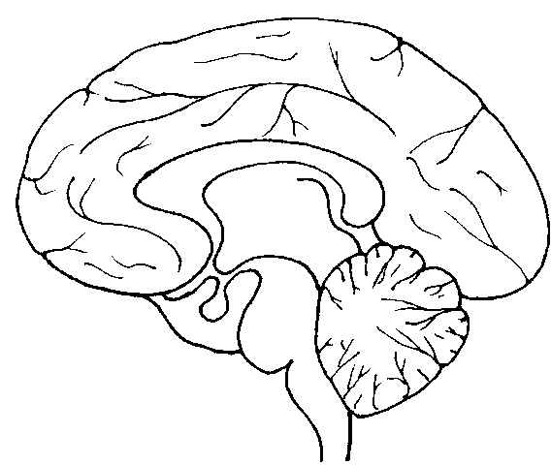
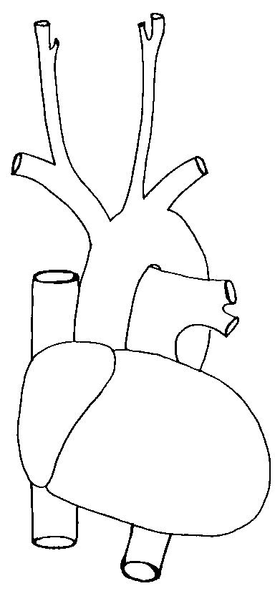
Respiratory reflexes
Sensory input from conscious area of the brain
Sensory input from other parts of the body
Sensory input from other parts of the body
Carbon dioxide and oxygen receptors
Respiratory centre
Nerve impulses to respiratory muscles

Slide 34
Control of breathing
Muscles that control the lungs – diaphragm (phrenic N.) and ICM (intercostal N.)
These nerves originate at neck and thorax levels
** What happens if an injury occurred at C7 region?**

Slide 35
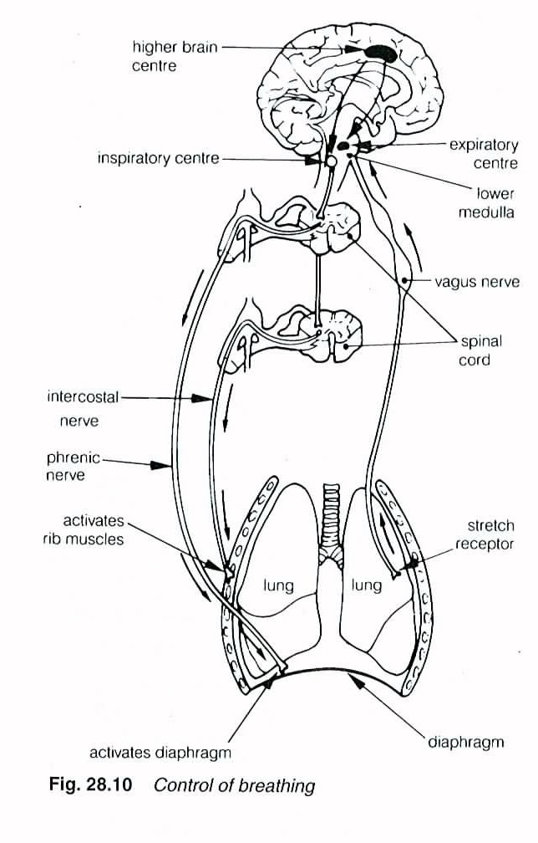
Breathing – control diagram

Slide 36
Oxygen – feedback loop for high oxygen levels
High oxygen conc in the blood STIMULUS
Chemoreceptors in the medulla, aorta & carotid arteries RECEPTOR
Oxygen decreased
Respiratory centre in the medulla MODULATOR
Negative feedback
Send a nerve impulse
Exhalation RESPONSE
Respiratory muscles (diaphragm & intercostal muscles) relax EFFECTOR

Slide 37
Oxygen – feedback loop for Low oxygen levels
Low oxygen conc in the blood STIMULUS
Chemoreceptors in the medulla, aorta & carotid arteries RECEPTOR
Oxygen increased
Respiratory centre in the medulla MODULATOR
Negative feedback
Send a nerve impulse
inhalation RESPONSE
Respiratory muscles (diaphragm & intercostal muscles) contract EFFECTOR

Slide 38
Hydrogen ions – feedback loop for high hydrogen ion levels
High hydrogen ion conc in the blood STIMULUS
Chemoreceptors receptors in the medulla, aorta & carotid arteries RECEPTOR
Hydrogen ions decreased
Expiratory centre in the medulla MODULATOR
Negative feedback
Send a nerve impulse
RESPONSE
Exhalation
Decr in volume in thoracic cavity, incr in pressure
Respiratory muscles (diaphragm & intercostal muscles) contract EFFECTOR

Slide 39
Hydrogen ions – feedback loop for low hydrogen ion levels
Low hydrogen ion conc in the blood STIMULUS
Chemoreceptors receptors in the medulla, aorta & carotid arteries RECEPTOR
Hydrogen ions increased
Inspiratory centre in the medulla MODULATOR
Negative feedback
Send a nerve impulse
Inhalation RESPONSE
Respiratory muscles (diaphragm & intercostal muscles) relax EFFECTOR

Slide 40
Carbondioxide – feedback loop for high Carbondioxide levels
High carbondioxide conc in the blood STIMULUS
Chemoreceptors in the medulla, aorta & carotid arteries RECEPTOR
Carbondioxide decreased
Expiratory centre in the medulla oblongata MODULATOR
Negative feedback
Send a nerve impulse
Exhalation RESPONSE
Respiratory muscles (diaphragm & intercostal muscles) contract EFFECTOR

Slide 41
Carbondioxide – feedback loop for low Carbondioxide levels
Low carbondioxide conc in the blood STIMULUS
Chemoreceptors in the medulla, aorta & carotid arteries RECEPTOR
Carbondioxide increased
Inspiratory centre in the medulla oblongata MODULATOR
Negative feedback
Send a nerve impulse
Inhalation RESPONSE
Respiratory muscles (diaphragm & intercostal muscles) relax EFFECTOR

Slide 42
HYPERVENTILATION
Definition – rapid, deep breathing
Description – rapid, deep breathing greatly decreases CO2 levels without increasing O2 levels

Slide 43
Dangers of Hyperventilation – dizziness & fainting
Cause
Due lack of carbon dioxide in the blood
This causes blood vessels in the brain to constrict reducing blood flow to the brain.
Correction
Breathe into a bag in order to breathe in recycled air that is high in carbon dioxide.

Slide 44
Dangers of Hyperventilation - drowning
Low CO2 levels underwater allows people to hold their breathe for longer
Underwater their bodies use O2 faster which then runs out
Meanwhile the CO2 levels do not reach levels to stimulate breathing
Person blacks out when oxygen runs out & person starts breathing under water causing drowning

